Slide 1
Costs and benefits of multi-species mutualisms
Ali Campbell
Notes:
Hi everyone, my name is Ali Campbell and I’m a second year graduate student in the Miller lab at Rice University. I’m sorry I couldn’t be there with you today, but I’m excited to talk about some of the research I worked on this past Summer.
I am going to be talking about a project where I am investigating the demographic consequences of multi-species mutualisms in comparison with pairwise mutualisms. Multispecies mutualisms are notoriously understudied and therefore not always well understood despite being much more common than pairwise mutualisms in nature. This research will help us understand potential consequences of biodiversity in similar systems.

Slide 2
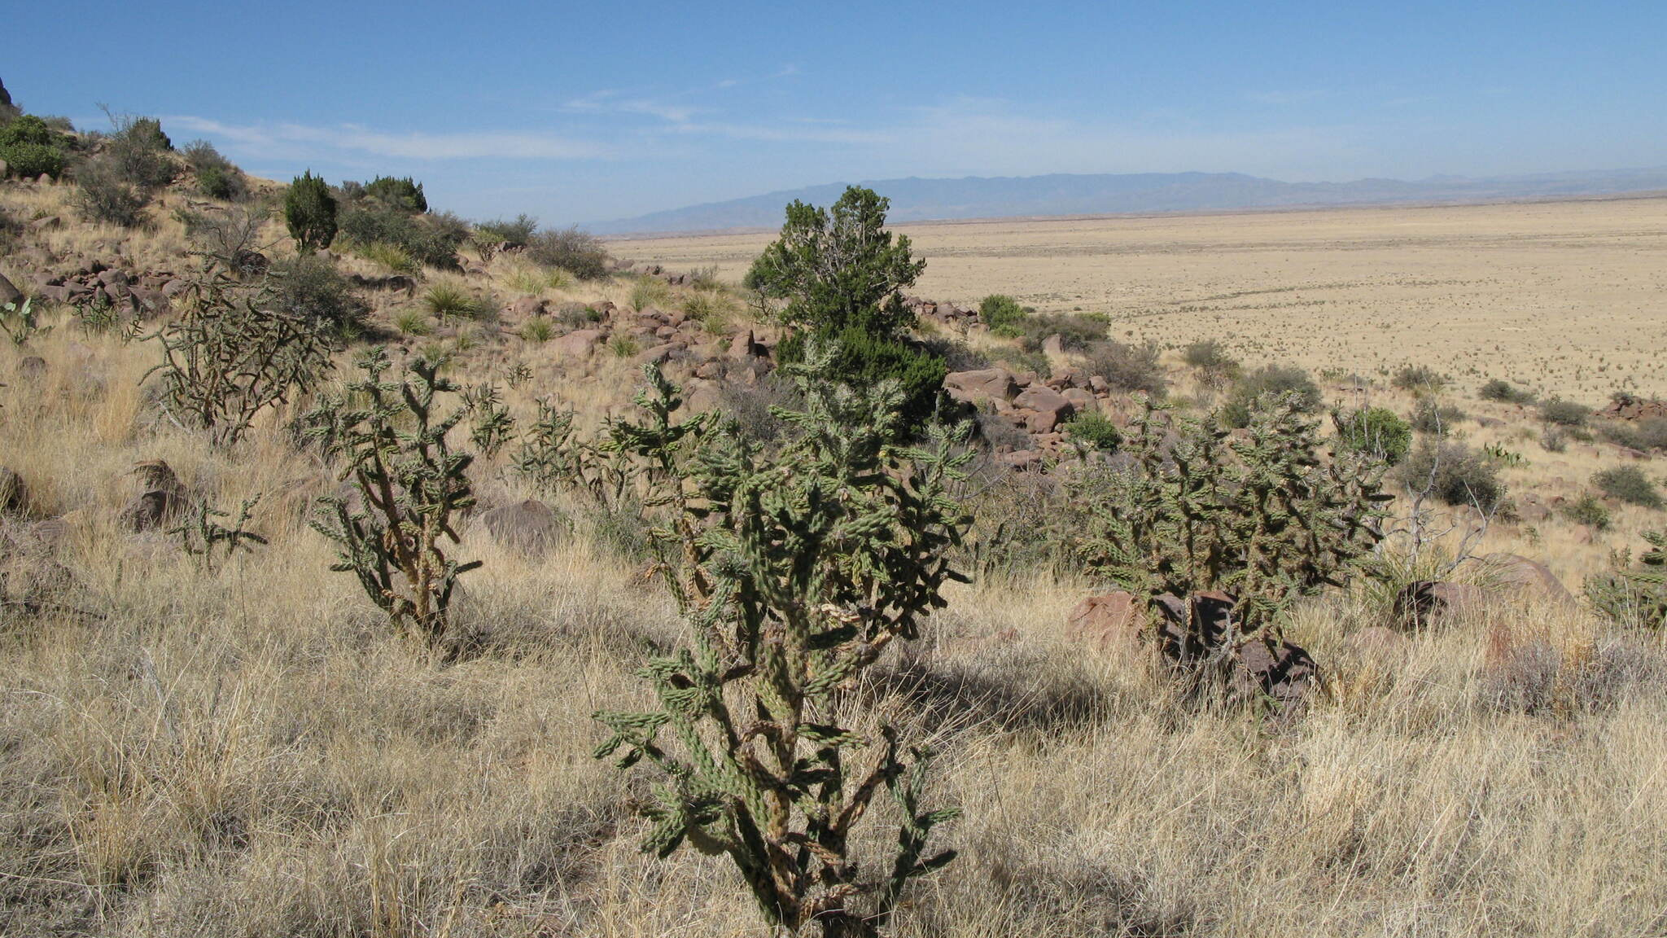
Cylindriopuntia imbricata
Cholla cacti are defended by ants
Ants collect nectar from the cacti
Only one ant species visit at a time
The ant partner can transition over time
Ants include: Liometopum, Cremategastor, Other.
Notes:
First, some context on the system I am using to study this. The Cylindriopuntia imbracata, or cholla cacti, are long lived large cacti which engage in facultative mutualisms with multiple ant species.
These ants defend the cacti from native herbivores, and in return they collect nectar from the plants extrafloral nectaries.
While across the cacti population there are multiple species of ant partners, on an individual cactus, there is only one. These ants are territorial and will fight for control of individual plants. However, across time the partners can transition based on a number of factors.
To understand the costs and benefits of these partners I am building a model which will let me quantitatively compare the fitness of the cacti in the current multispecies mutualisms to the fitness if they had any one partner. This model is still being built, but I am going to share some preliminary results today.

Slide 3
Results

Slide 4
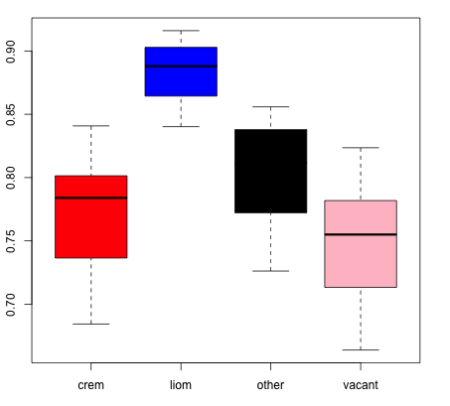
Liometopum offer reproductive advantages
Viability Rates
Ant Species
Notes:
One hypothesis for how biodiversity is maintained is complementarity, the idea that different species offer different benefits. I have found some pretty cool preliminary evidence that the different partners observed in this system offer slightly different advantages. Here you can see the ant partner on the x axis and the viability rate of offspring on the y axis.
Here you can clearly see that liometopum tended plants have the highest offspring viability rates. Alone this may not show complementarity, but when compared with this second result,

Slide 5
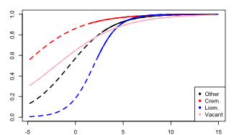
Cremategastor offer survival advantages for small plants
Survival Rates
Log(Volume)
Notes:
What you can see is that liometopum does not universally offer the highest vital rates.
On the x axis is the size and on the y axis is the survival rate of the cacti. Beyond a certain size, the survival rates of all groups are roughtly equal, but for small cacti they differ significantly and importantly.
Here, the cremategastor tended plants have the highest survival rates for small plants indicating that they may be better partners for pre-reproductive plants.
Together these results indicate preliminary evidence of complementarity, which is associated with increased fitness for multispecies mutualisms.

Slide 6
New Ideas

Slide 7
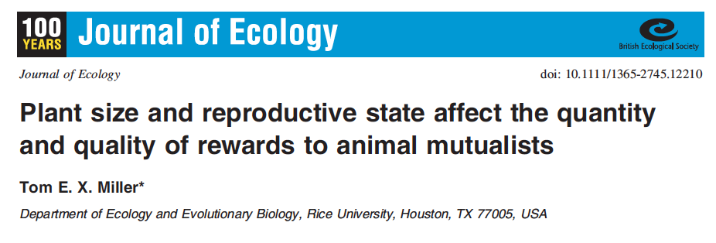
Include Extrafloral nectar Chemistry in Models

Slide 8
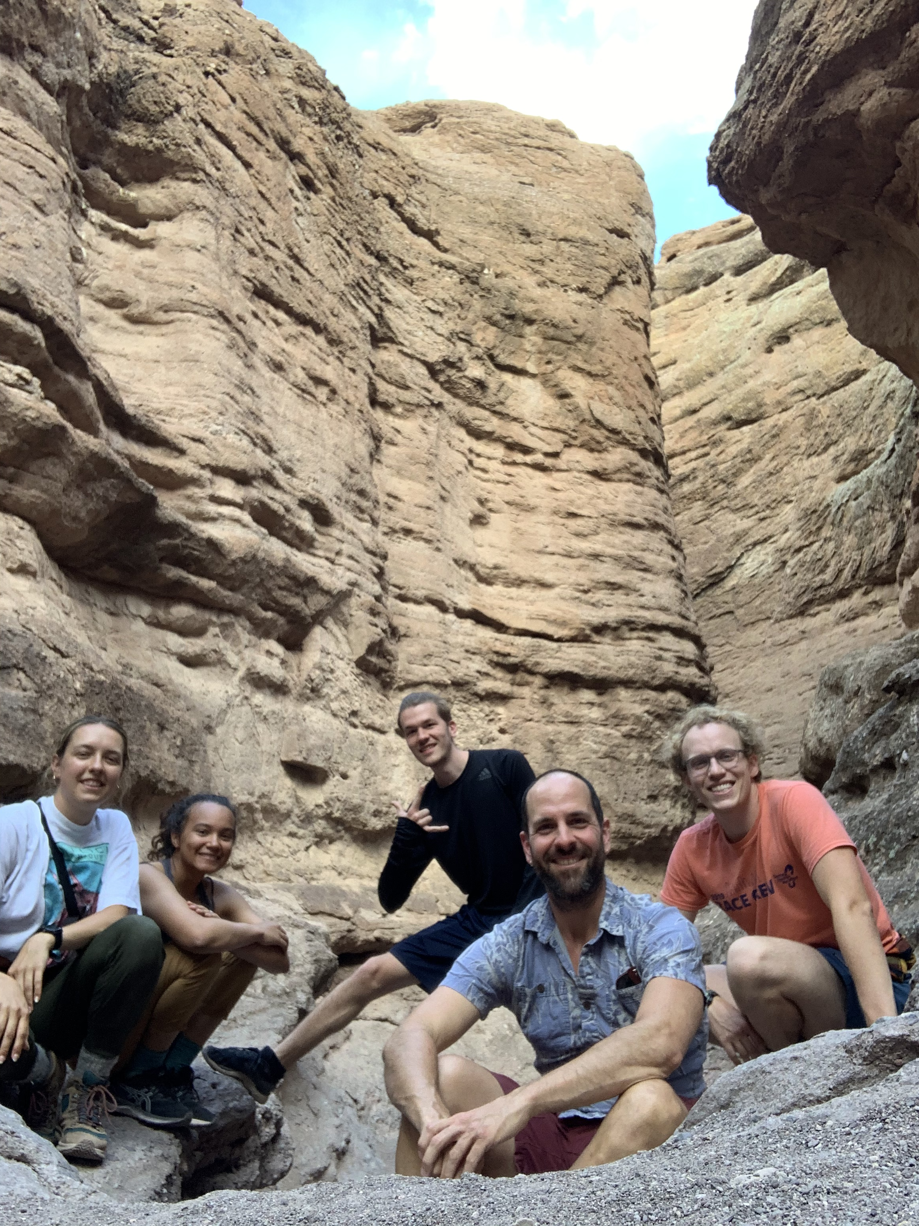
Thank you to:
Sevilleta LTER
Miller Lab & Undergraduate researchers
Rice University

